Slide 1

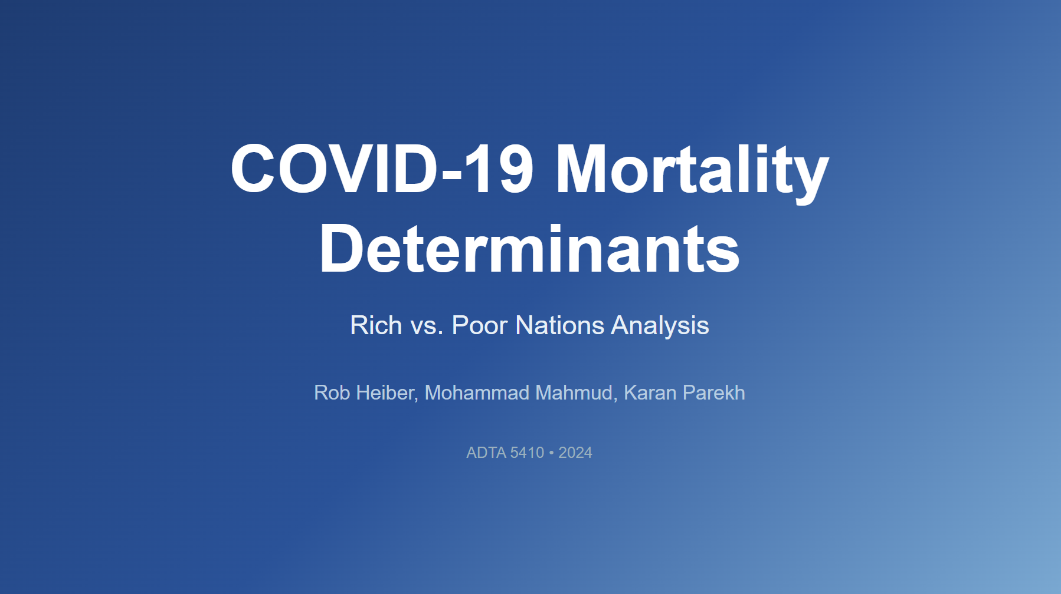

Slide 2

Our thoughts behind this research
The "Two Pandemics" Gap: Early data suggested high-income countries were hit harder, but demographic models predicted worse outcomes for developing nations. We wanted to test this discrepancy.
Data Availability Pivot: We initially sought Excess Mortality Rates, but daily data was unavailable. We pivoted to "Total Deaths" which had consistent daily country-level reporting.
Rich vs. Poor Split: We used Decision Tree Regressors (not just linear models) to capture non-linear relationships among 11 variables and wanted to explore whether wealth made any differences in total deaths.
https://pngtree.com/freepng/thinking-man-illustration-with-question-mark-and-light-bulb-for-business-transparent-background-vector_8803664.html

Slide 3

Few References (Key Literature)
Karlinsky & Kobak (2021): Developed the World Mortality Dataset; showed true death tolls were often 100x higher in some developing nations than reported.
Pablos-Méndez et al. (2022): Found higher GDP was positively associated with mortality (b = 0.512), mostly due to older populations in rich countries.
Hale et al. (2021): Showed government policy (Stringency Index) was effective, with a 10-point increase reducing daily deaths by 6%.
Msemburi et al. (2023): WHO estimates showing 14.83 million excess deaths, nearly 3x official counts.
https://researchmethod.net/references-in-research/

Slide 4
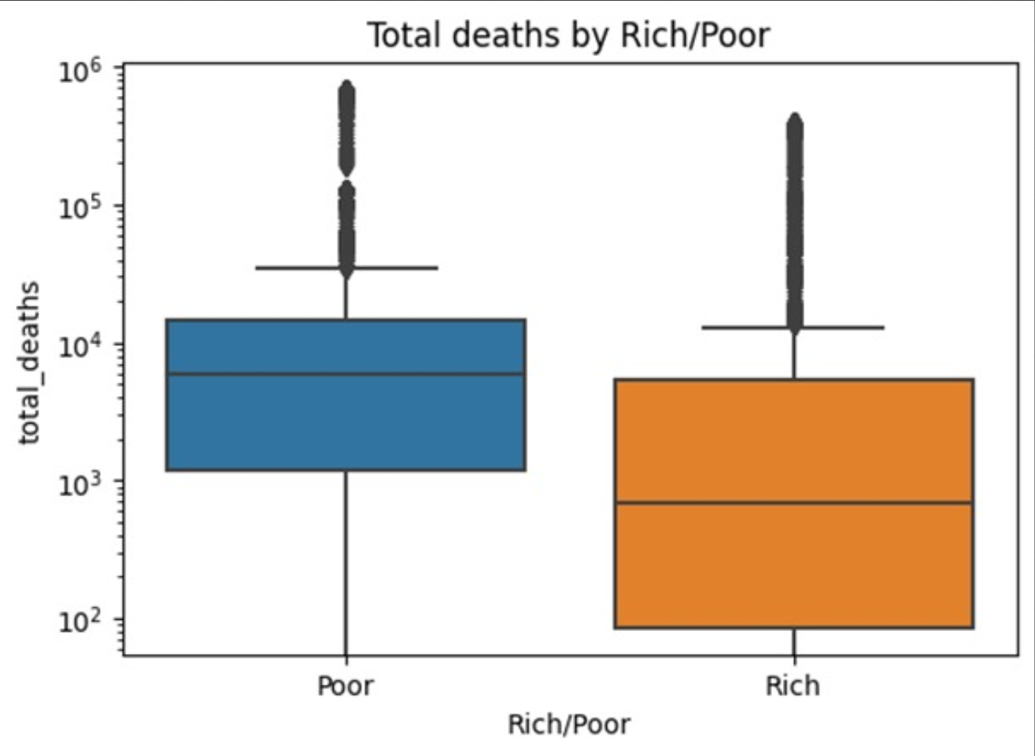
Research Question
What variables drive total death across Rich vs Poor countries during Covid-19?

Slide 5
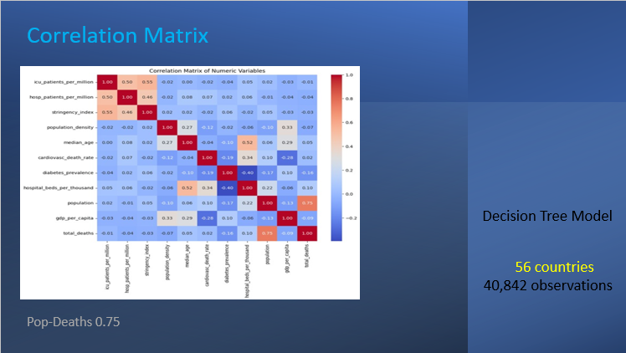

Slide 6
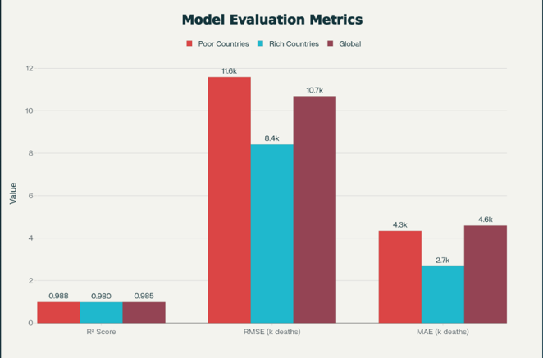
Model Performance Matrix
All $R^{2}≥$ 0.980 | Exceptional Predictive Accuracy

Slide 7
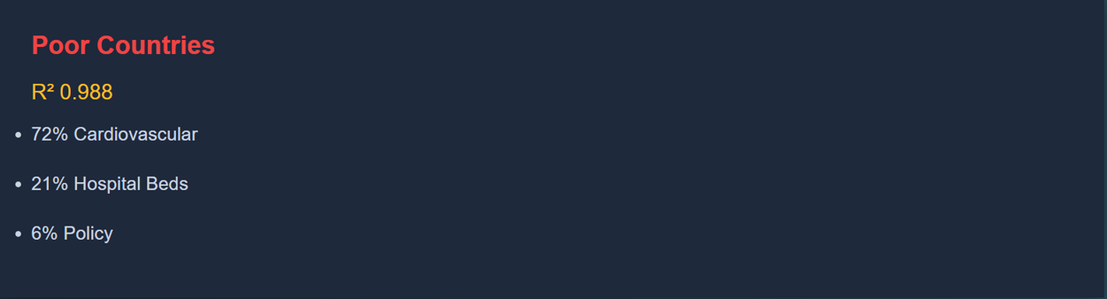
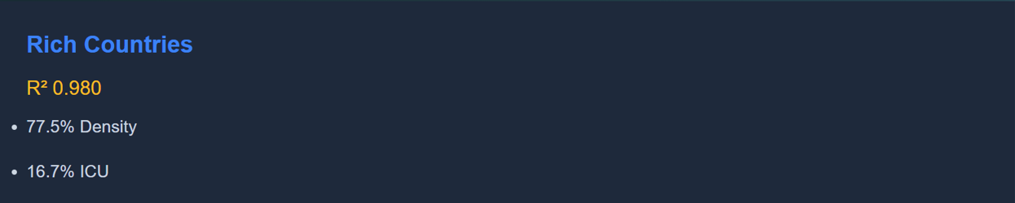
Key Findings Across Groups
Extremely high R² values indicates potential overfitting. Probable fix: running k-fold cross-validation, testing on out-of-sample or out-of-time datasets, and evaluating the stability of feature contribution.

Slide 8
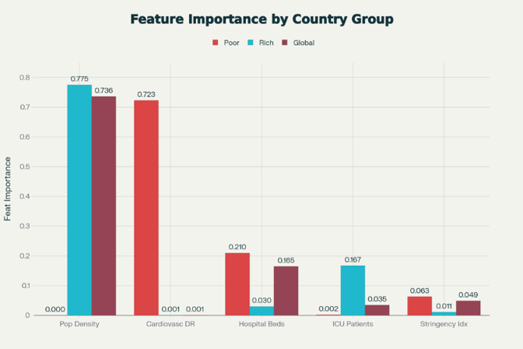
Feature Importance Comparison
Critical Insights
✓ Structural factors outweigh income

Slide 9
